Slide 1


5th semester DBMS Mini Project HOTEL MANAGEMENT SYSTEM
PRESENTED BY: GUIDED BY: GUIDED BY:
Latharani (1DB20CS405) Mrs Sumathi M Mrs Shruthi G
Neha A (1DB19CS094) Asst. Professor Asst Professor
Department of Department of
CSE CSE
DBIT DBIT
Department Of Computer Science And Engineering
Don Bosco Institute Of Technology Mysore Road , Kumbalagodu Bangalore

Slide 2
AGENDA
INTRODUCTION
ABSTRACT
AIM AND OBJECTIVE
TABLE LIST
ER DIAGRAM
SCHEMA DIAGRAM
CONCLUSION
REFERENCE

Slide 3
INTRODUCTION
Hotel management system is a hotel reservation site script where site users will be able to search rooms availability with an online booking reservations system.
Site users can also browse hotels, view room inventory, check availability, and book reservations in real-time.
Site users enter check in date and check out date then search for availability and rates.
After choosing the right room in the wanted hotel – all booking and reservation process is done on the site and an SMS is sent to confirm the booking.
Administrator panel account manager - administrator – administrator can manage administrator accounts and conform the rooms.
- Room types – administrator can define the type of rooms in the hotels, room’s prices and upload an image for each room.
- Bookings – all booking and reservations maid on the site are displayed with all booking details: arrival date, departure date, hotel name, room type, number of passengers, price.

Slide 4
ABSTRACT
Which Can Be Used By Customers To Reserve Hotel Rooms.
Users Can Check The Availability Of Rooms And Facilities.
The Users Can Register And Log Into The System.
The Administrator Will Know The Details Of Reservation And Daily Income.
This Project Aims At Creating An OnlineHotel Management System

Slide 5
AIM AND 0BJECTIVE
The Main Objective Of Hotel Organizations Could Be Improved By Integrating Service-oriented Operations Service-oriented Operations With Project Management Principles.
Such Integration Would Instill Innovation, Proactive Attitudes And Regulated Risk-taking Needed To Pursue Ongoing Improvement And Proactive Response To Change.
By Managing Each Change As A Project, Embedded In Smoothly Running Operations, Hotels Would Extend Their Life Span By Continuously Reinventing Themselves.
Due To Which The Customers Can Easily Book The Hotels Rooms.

Slide 6
TABLE LIST
CREATE TABLE CONTACT(
ID INT(10) UNSIGNED NOT NULL,
FULLNAME VARCHAR(100) DEFAULT NULL,
PHONENO INT(10) DEFAULT NULL,
EMAIL TEXT,
CDATE DATE DEFAULT NULL,
APPROVAL VARCHAR(12) DEFAULT NULL);
CREATE TABLE NEWSLETTERLOG(
ID INT(10) UNSIGNED NOT NULL,
TITLE VARCHAR(52) DEFAULT NULL,
SUBJECT VARCHAR(100) DEFAULT NULL,
NEWS TEXT);

Slide 7
CREATE TABLE LOGIN(
ID INT(10) UNSIGNED NOT NULL,
USNAME VARCHAR(30) DEFAULT NULL,
PASS VARCHAR(30) DEFAULT NULL);
CREATE TABLE ROOM(
ID INT(10) UNSIGNED NOT NULL,
TYPE VARCHAR(15) DEFAULT NULL,
BEDDING VARCHAR(10) DEFAULT NULL,
PLACE VARCHAR(10) DEFAULT NULL,
CUSID INT(11) DEFAULT NULL);

Slide 8
CREATE TABLE PAYMENT(
ID INT(11) DEFAULT NULL,
TITLE VARCHAR(5) DEFAULT NULL,
FNAME VARCHAR(30) DEFAULT NULL,
LNAME VARCHAR(30) DEFAULT NULL,
TROOM VARCHAR(30) DEFAULT NULL,
TBED VARCHAR(30) DEFAULT NULL,
NROOM INT(11) DEFAULT NULL,
CIN DATE DEFAULT NULL,
COUT DATE DEFAULT NULL,
TTOT DOUBLE (8,2) DEFAULT NULL,
FINTOT DOUBLE (8,2) DEFAULT NULL,
MEPR DOUNLE(8,2) DEFAULT NULL,
MEAL VARCHAR(30) DEFAULT NULL,
BTOT DOUBLE(8,2) DEFAULT NULL,
NOOFDAYS INT(11) DEFAULT NULL);

Slide 9
CREATE TABLE ROOMBOOK(
ID INT(10) UNSIGNED NOT NULL,
TITLE VARCHAR(5) DEFAULT NULL,
FNAME TEXT,
LNAME TEXT,
EMAIL VARCHAR(50) DEFAULT NULL,
NATIONAL VARCHAR(30) DEFAULT NULL,
COUNTRY VARCHAR(30) DEFAULT NULL,
PHONE TEXT,
TROOM VARCHAR(20) DEFAULT NULL,
BED VARCHAR(10) DEFAULT NULL,
NROOM VARCHAR(2) DEFAULT NULL,
MEAL VARCHAR(15) DEFAULT NULL,
CIN DATE DEFAULT NULL,
COUT DATE DEFAULT NULL,
STAT VARCHAR(15) DAFAULT NULL,
NODAYS INT(11) DEFAULT NULL);

Slide 10
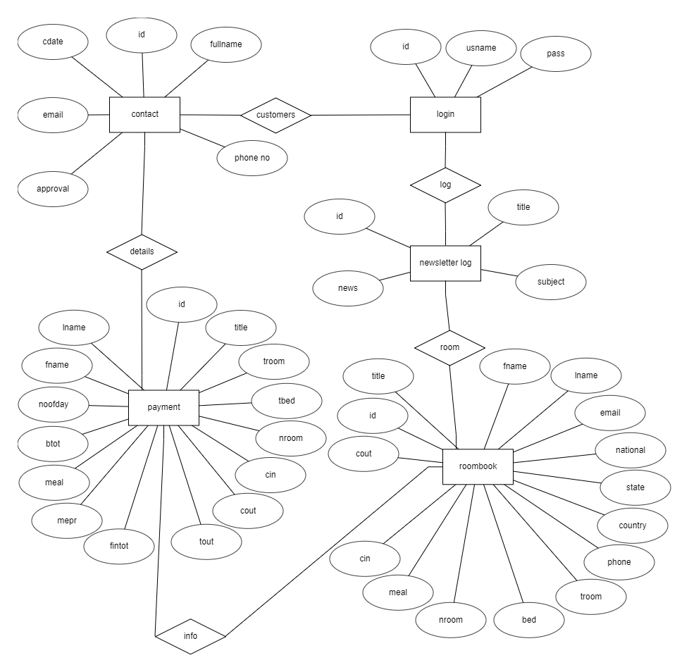
ER DIAGRAM

Slide 11
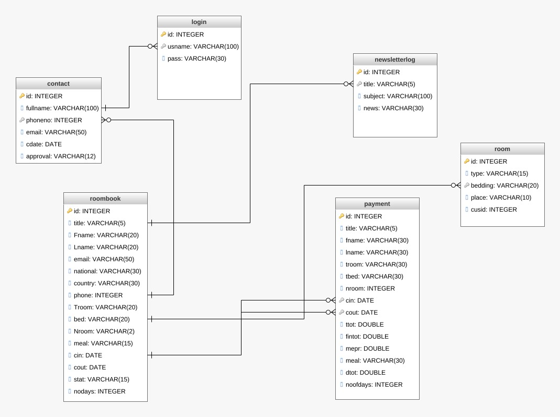
SCHEMA DIAGRAM

Slide 12
CONCLUSION
The Online Hotel Reservation System Was Developed To Replace The Manual Process Of Booking For A Hotel Room Or Any Facility Of The Hotel
We Have Learnt How To Make A System User Friendly
While Developing This Project We Learnt A Lot About Hotel Management
During The Development Process Studied Carefully And Understood Process

Slide 13
Thank You

